Slide 1
7: Sensory Corners and ‘Sensory on a Shoestring.’
7A: Introduction to Sensory Corners including Advantages and Disadvantages
www.multisensorylearning.lgfl.net ©2018 www.hirstwood.com & London Grid for Learning

Slide 2
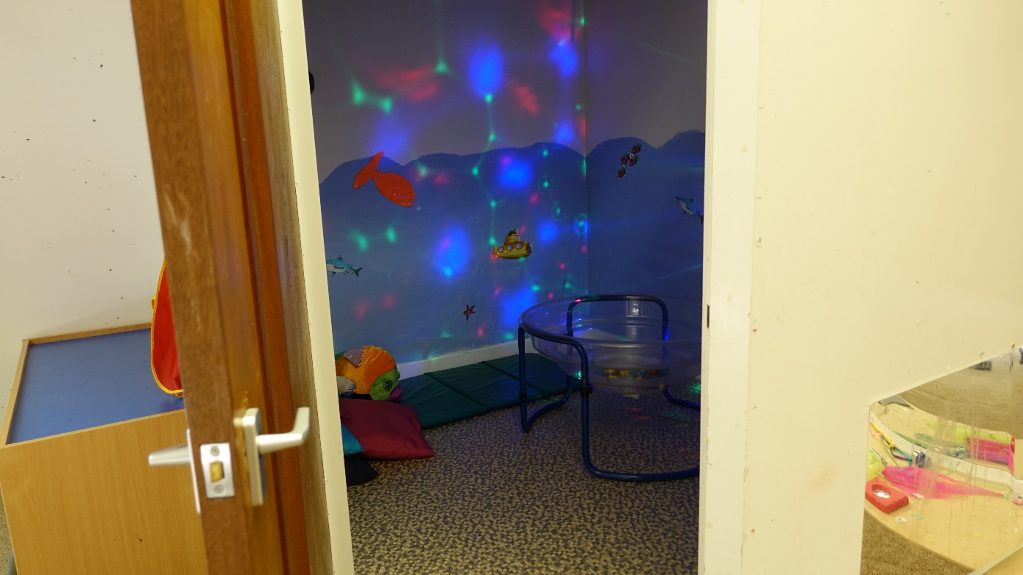
Advantages of a sensory corner
It is available at any time for learners to access.
A flexible learning experience which is easily changed
www.multisensorylearning.lgfl.net ©2018 www.hirstwood.com & London Grid for Learning

Slide 3
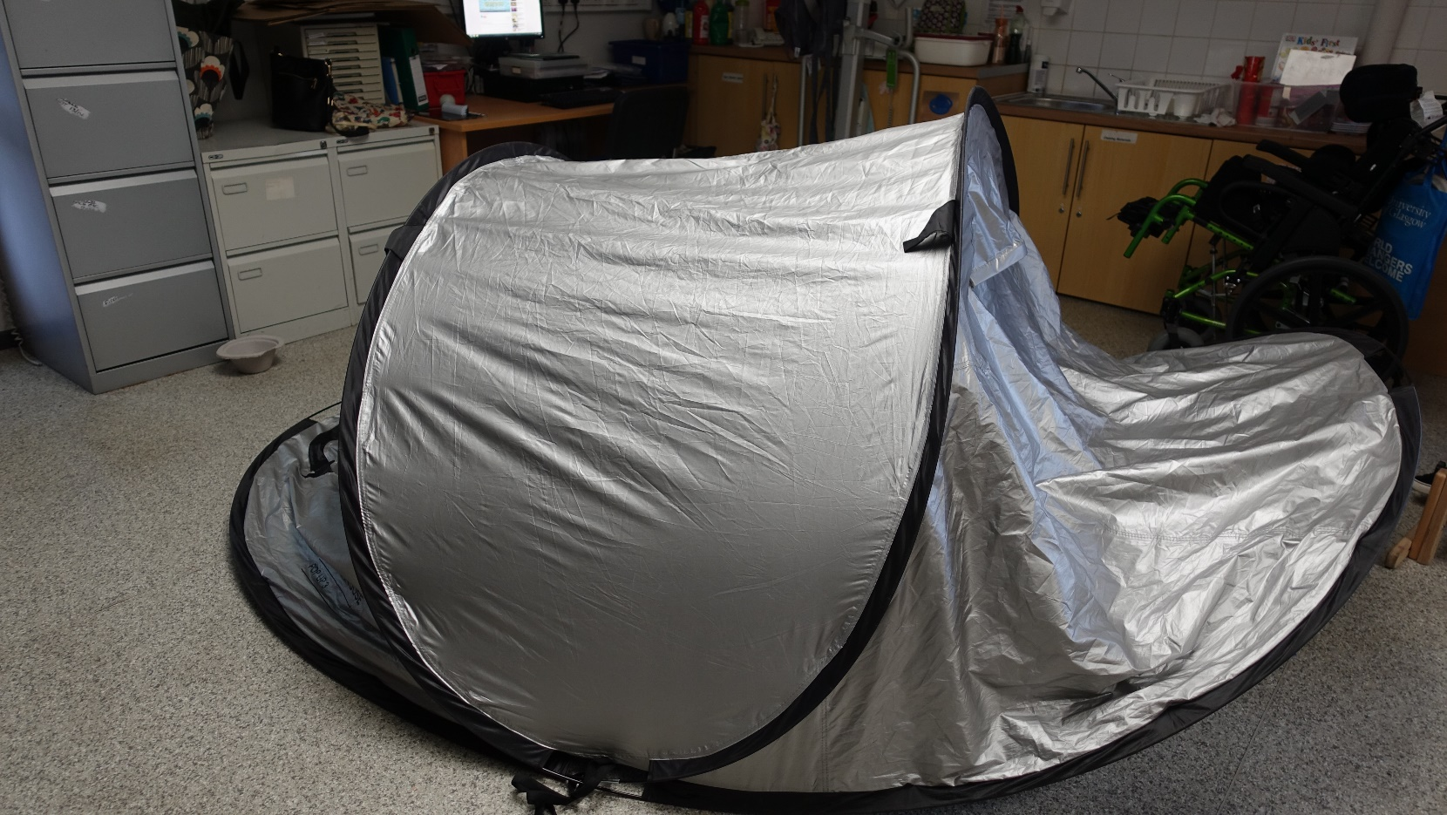
Advantages of a sensory corner
Broken items are easy to find and replace at a low cost
www.multisensorylearning.lgfl.net ©2018 www.hirstwood.com & London Grid for Learning

Slide 4
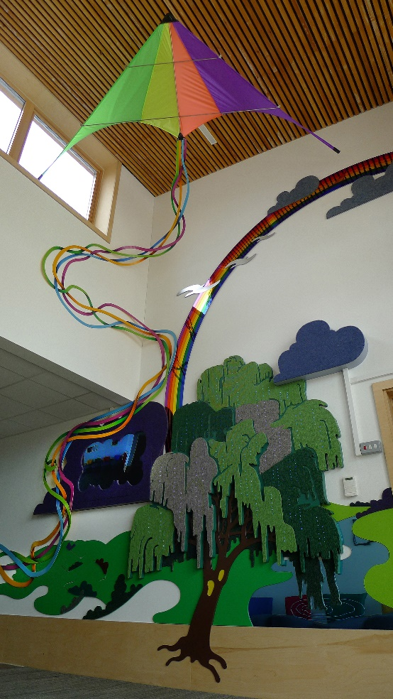
Advantages of a sensory corner
It can be themed to match the current curriculum topics
www.multisensorylearning.lgfl.net ©2018 www.hirstwood.com & London Grid for Learning

Slide 5
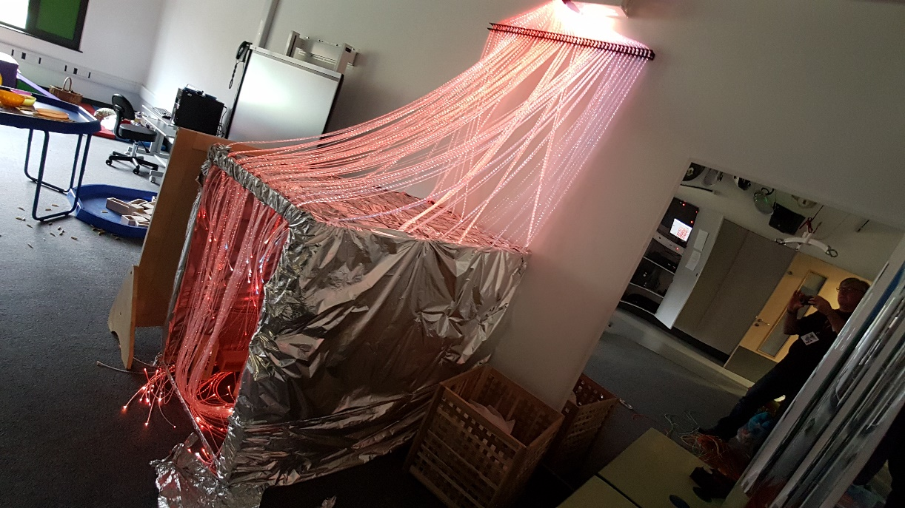
Advantages of a sensory corner
Provides an ‘escape’ for learners to refocus, whilst remaining in class
Less need for staff training as resources are everyday items
www.multisensorylearning.lgfl.net ©2018 www.hirstwood.com & London Grid for Learning

Slide 6
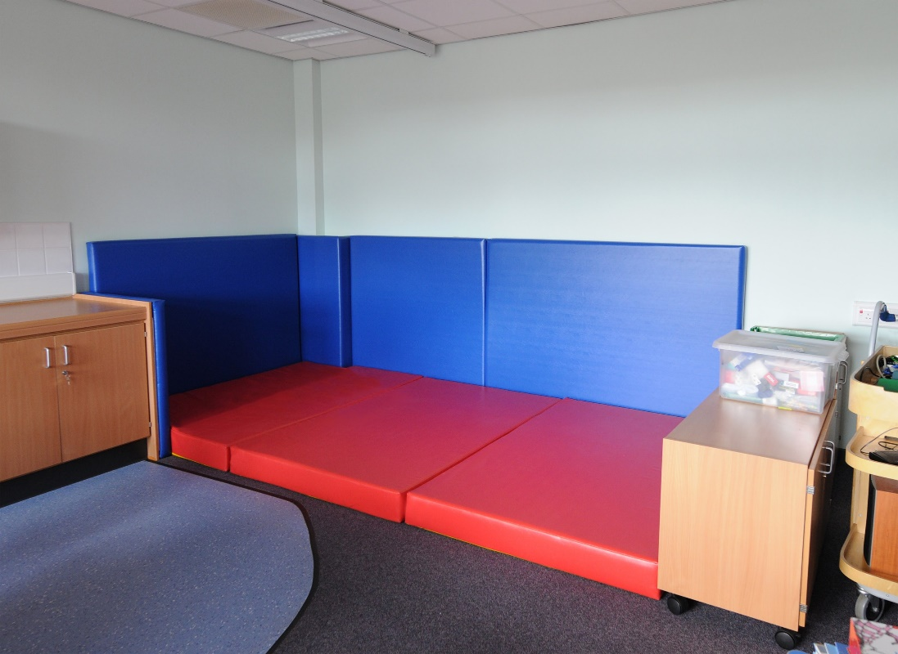
Disadvantages of a sensory corner
Portable equipment may not be as robust and so break more easily
Things get borrowed - and may not be brought back!
Storage space may be needed for equipment
www.multisensorylearning.lgfl.net ©2018 www.hirstwood.com & London Grid for Learning

